Slide 1
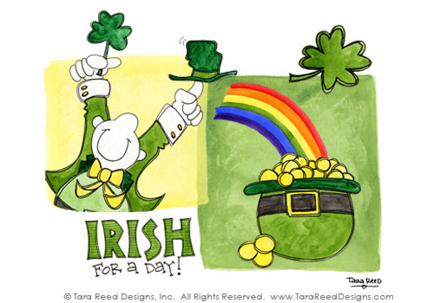
St. Patrick's Day
Notes:
2/28/17
1
1

Slide 2
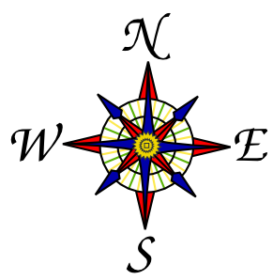
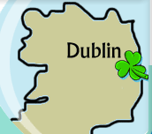
Ireland
Ireland is an island to the northwest of continental Europe.
It is the third-largest island in Europe.
People who live in Ireland are called Irish.
The capital city of Ireland is Dublin.
Notes:
2/28/17
2
2

Slide 3
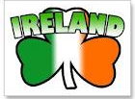
Symbols of Ireland
The national flag of Ireland is green white, and orange.
A shamrock is a three-leaved clover.
Three is Ireland´s magic number and the Irish say three-leafed shamrocks bring good luck.
Notes:
2/28/17
3
3

Slide 4
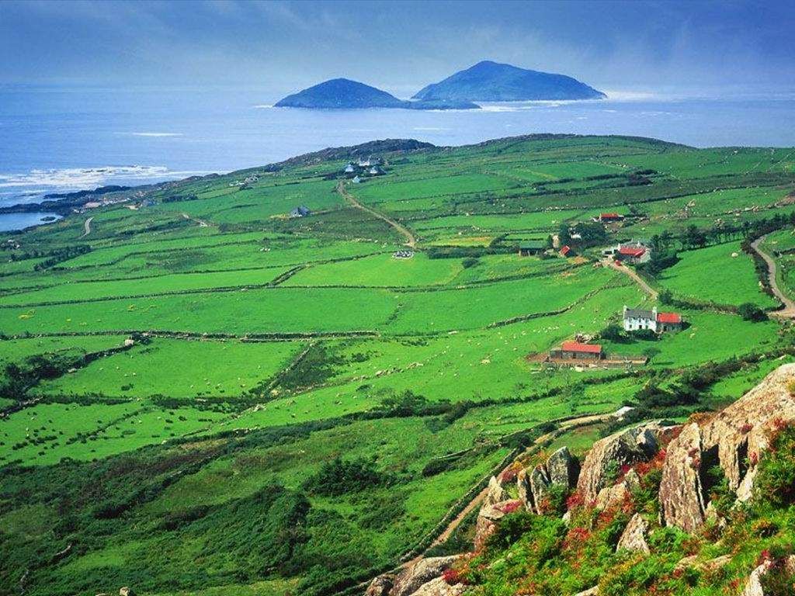
The Emerald Isle
Green is the Irish color.
First, because the green shamrock leaf is the national plant of Ireland.
Secondly, because Ireland is called the “Emerald Isle” because of its vast green pastures.
Notes:
2/28/17
4
4

Slide 5
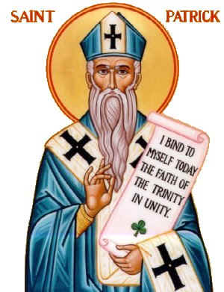
Saint Patrick's Day
Saint Patrick´s Day is celebrated each year on March 17th.
In Ireland, Saint Patrick´s Day is a national holiday.
Saint Patrick is the patron saint of Ireland.
Notes:
2/28/17
5
5

Slide 6
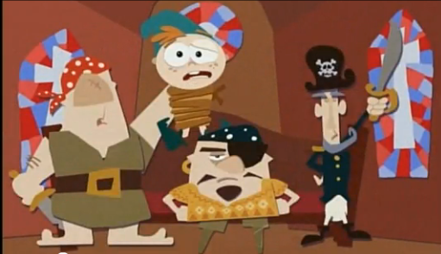
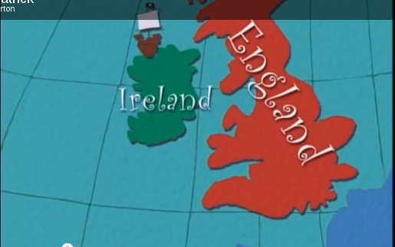
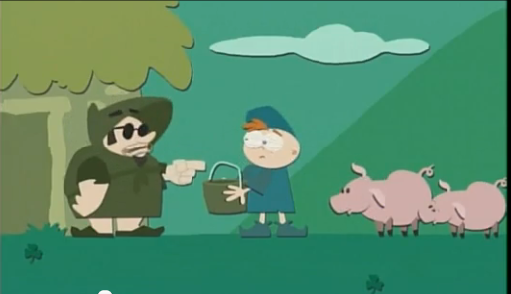
Saint Patrick's Life
He was born in the year 385 and died on March 17th around the year 460.
Saint Patrick had an adventurous life. He was captured by pirates at the age of 16. The Irish pirates brought him to England and sold him as a slave.
Notes:
2/28/17
6
6

Slide 7
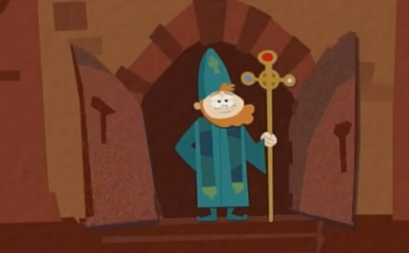
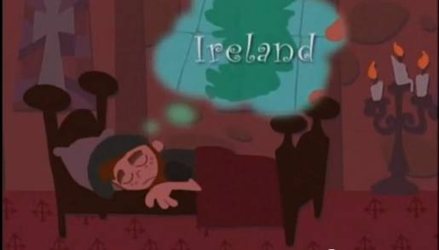
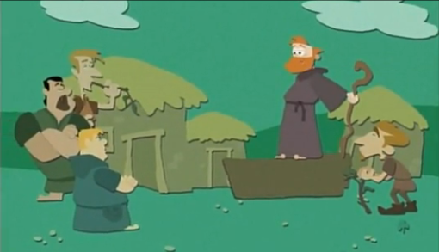
Saint Patrick's life
He escaped to France and became a monk.
In 432, he returned to Ireland. He was the one who brought Christianity to the Irish. He taught many of the people of Ireland to read and write.
Notes:
2/28/17
7
7

Slide 8
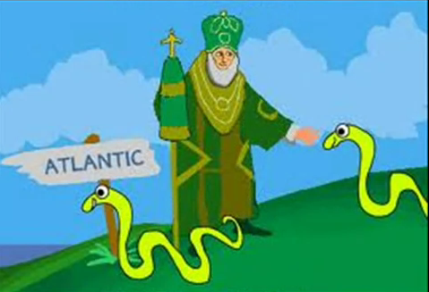
St. Patrick and the snakes
According to another legend, St. Patrick drove all the snakes in Ireland out of the country and into the sea. The absence of snakes in Ireland gave rise to the legend that they had all been banished by St. Patrick chasing them into the sea after they attacked him during a 40-day fast he was undertaking on top of a hill.
Notes:
2/28/17
8
8

Slide 9
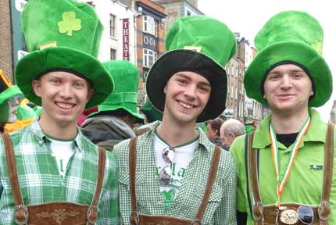
St. Patrick's Day
Although St. Patrick's Day began in Ireland, it is celebrated in countries around the world.
Many people wear green on this day.
Notes:
2/28/17
9
9

Slide 10
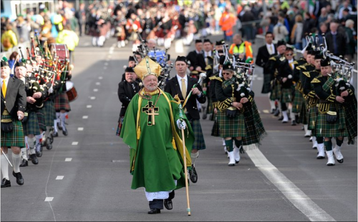
St. Patrick's Day parades
Saint Patrick’s Day is usually celebrated with a parade. The one in Dublin, the capital city of Ireland, is known to some as the Irish Mardi Gras.
The first St. Patrick’s Day celebration in the United States was held in Boston in 1737. The largest St. Patrick’s Day parade is in New York City. It lasts for hours.
Notes:
2/28/17
10
10

Slide 11
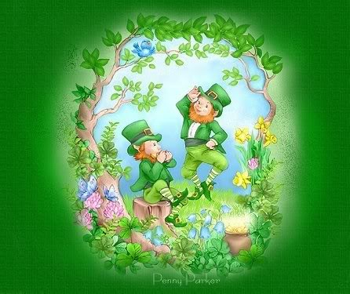
Irish legends
There are legends that go along with Saint Patrick’s Day. A popular legend is about the leprechaun. Leprechauns are tiny people dressed in green and they collect pots of gold.
Notes:
2/28/17
11
11

Slide 12
Irish legends
The legend says that if you catch a leprechaun, he will lead you to his pot of gold. Leprechauns hide their pots of gold at the end of the rainbow.
And if you are lucky enough to find a lepechaun, don´t take your eyes off him, becouse he´ll dissapear with his pot of gold.
Notes:
2/28/17
12
12

Slide 13
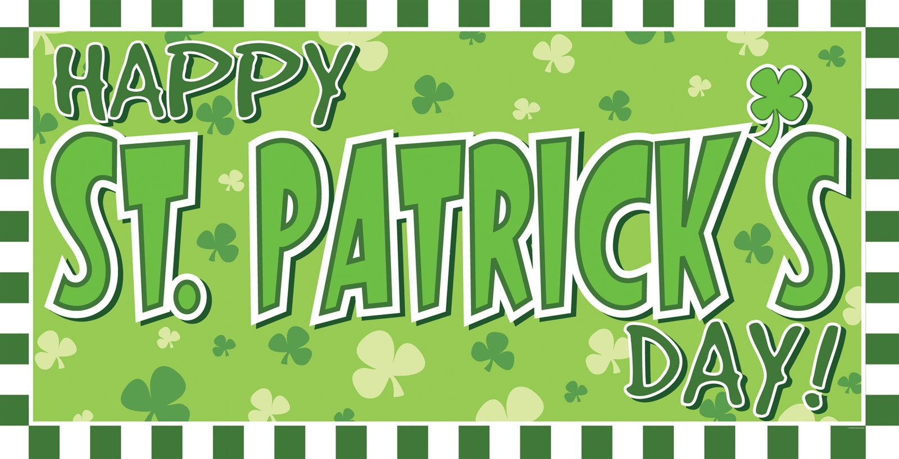
Notes:
2/28/17
13
13

